Slide 1
Jermyn Borough Council Meeting
03/21/2024

Slide 2
Meeting Agenda
March 21,2024
CALL TO ORDER
PLEDGE OF ALLEGIANCE
ROLL CALL
PREVIOUS MEETING MINUTES
TREASURER REPORT/BILLS PAYABLE
SECRETARY REPORT
CORRESPONDENCE
PUBLIC COMMENT
PROFESSIONAL REPORTS-POLICE, FIRE, SOLICITOR, ZONING, ENGINEER, TAX COLLECTOR, MAYOR
COMMITTEE REPORTS-SAFETY, PLANNING, FINANCE, SHADE TREE, REC, MS4, DPW
WOODLANDS SEWER PROJECT PHASE 2 BID OPENING
RUSHBROOK CREEK
EXECUTIVE SESSION
NEW BUSINESS

Slide 3
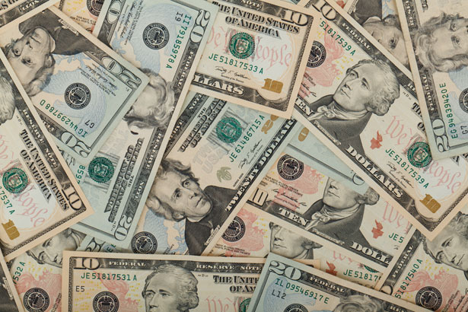
Treasurer’s report
3/21/2024
ASSETS
Checking/Savings
American Rescue Plan Fund 135,747.33
Capital Reserve - DPW 909.52
Capital Reserve - Police 5,414.82
Crime Watch Fund 222.69
General Fund - Community 35,930.28
General Fund - FNB 5,638.81
Holiday Lights Fund 1,459.09

Slide 4
Treasurer’s report
Investment - General Fund 1,073.86
Investment - Liquid Fuels 23,644.31
Investment - Paving Fund 1,085.04
Investment - Recycling 118.59
Investment - Refuse 169.11
Liquid Fuels - FNB 71,624.78
Petty Cash 221.50
Recreations Fund 30,224.45
Recycling - Community 3,468.14
Refuse Checking - FNB 28,270.90
Total Checking/Savings 345,223.22

Slide 5
Treasurer’s report
200000 · Accounts Payable 14,004.26
Long Term Debt 164,379.15

